Slide 1

Project:
Surface Crack Detection using CNN
Under the guidance of
ANIRBAN BOSE
ASSISTANT PROFESSOR
By:
MIRAJUL HOQUE • SHOUVIK KHAN
SATTRAJIT SAHA • SOMNATH DAS
PARTHAJIT RANA • PANKAJ KUMAR
SAYANTAN DAS
Department of Mechanical Engineering
Meghnad Saha Institute of Technology, Kolkata

Slide 2
SURFACE CRACK ? Objective of Project ?
Data Images
These High-resolution images have variance in terms of surface ﬁnish and illumination conditions.
Each class [Cracked and Not cracked] has 20000 images with a total of 40000 images with 227 x 227 pixels with RGB channel
The dataset contains concrete images having cracks. The data is collected from various METU Campus Buildings.
The dataset is divided into two classes as negative and positive crack images for image classiﬁcation.

Slide 3
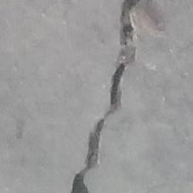
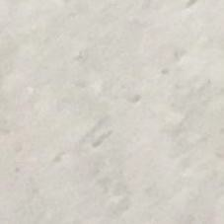
Model Overview
Data Preprocessing
Convolutional Layers with Max Pooling
Dense Fully Connected Layers Loss Function and Optimizer

Slide 4



Reduce the spatial size of the Convolved Feature, Extract dominant features
The images Dataset divided into two classes
Model which predicts the cracks in testing data with >98% accuracy
Flattening
Convolution Layers
Max Pooling Layers
Dense Layers
INPUT
OUTPUT
Alternatively repeated
Detect features that help classiﬁcation, by picking up edges and curves and then detecting shapes.
Learning non-linear combinations of the high-level features represented by the output of the convolutional layer.

Slide 5
Data Preprocessing
Re scaling images to 128 X 128 pixels
Why 128 ?
Power of 2 [We will perform Pooling with strides=2 thus reducing the output image size to half the input dimensions at each pooling layer]
80-20 distribution
Data Augmentation
Horizontal Flipping
Vertical Flipping
Random Rotation - nearest ﬁll mode
Why? => Prediction accuracy of the Supervised Deep Learning models is largely reliant on the amount and the diversity of data available during training

Slide 6
Convolutional Layers
Inside the model
We use the 3X3 and 1x1 convolutional ﬁlters.
Regularization : L2 => “squared magnitude” of coeﬃcient as penalty term to the loss function.
Purpose
Does feature extraction, using convolutional ﬁlters, rectilinear activation, and further subsampling.

Slide 7
Pooling Layer
Why Pooling?
Pooling layer is responsible for reducing the spatial size of the Convolved Feature
Decrease the computational power required to process the data through dimensionality reduction
Why Max Pooling ?
Max Pooling also performs as a Noise Suppressant. It discards the noisy activations altogether and also performs de-noising along with dimensionality reduction
This is the reason Max Pooling is considered better over other options

Slide 8
Dense Layers
Why at the end?
The dense layers at the end form a neural network that takes in the high-level features and classify the images on the basis of these features.
These are the layers actually responsible for classiﬁcation.
Deep is better than Wide
Deeper networks capture the natural “hierarchy” that is present everywhere in nature. It captures low level features in ﬁrst layer, a little better but still low level features in the next layer and at higher layers object parts and simple structures are captured.

Slide 9
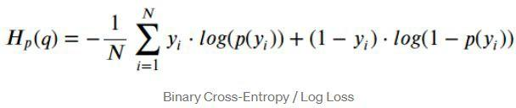
Optimization
Loss Function
Binary Cross Entropy
Optimizer
Adam
The method computes individual adaptive learning rates for diﬀerent parameters from estimates of ﬁrst and second moments of the gradients.

Slide 10
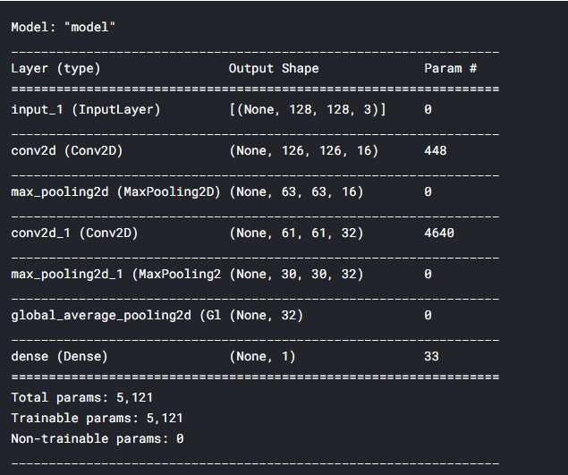
Model Summary - [keras backend]

Slide 11
We were able to train the model 97% accuracy on training data
> 98% accuracy on the validation dataset
Results

Slide 12
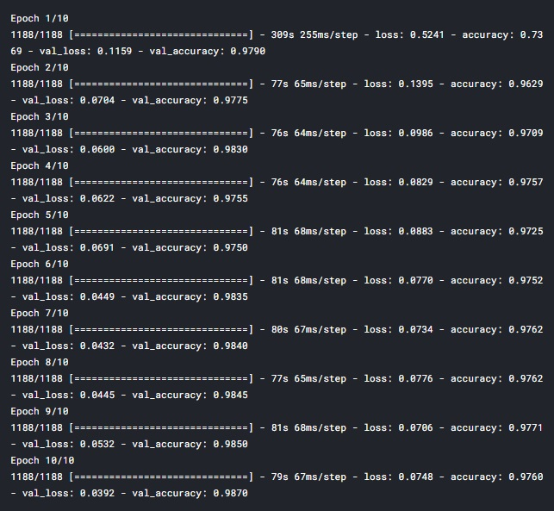
Results

Slide 13
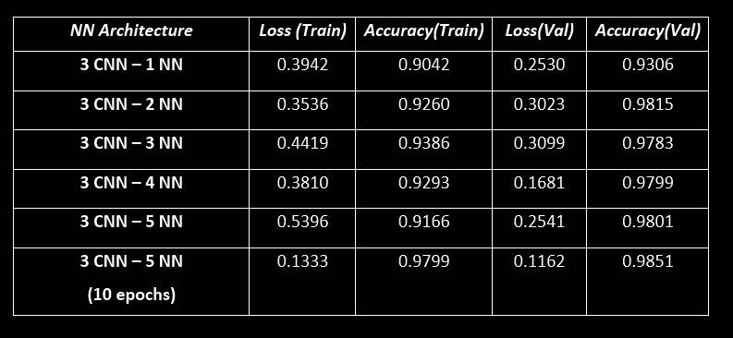
Extra : Insight into dense neural networks [1 epoch]

Slide 14
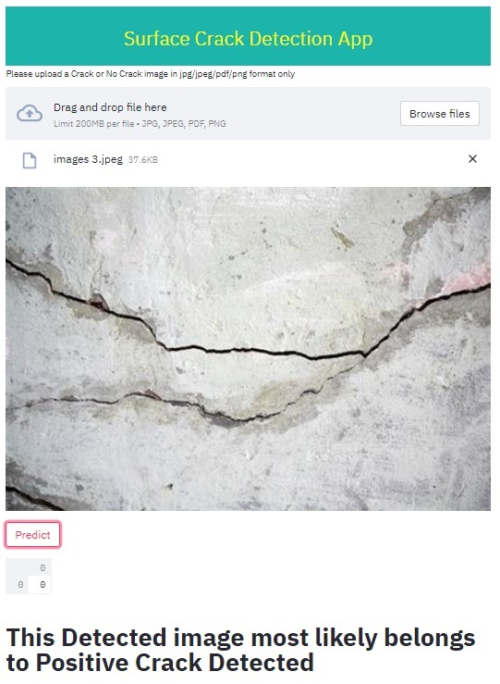
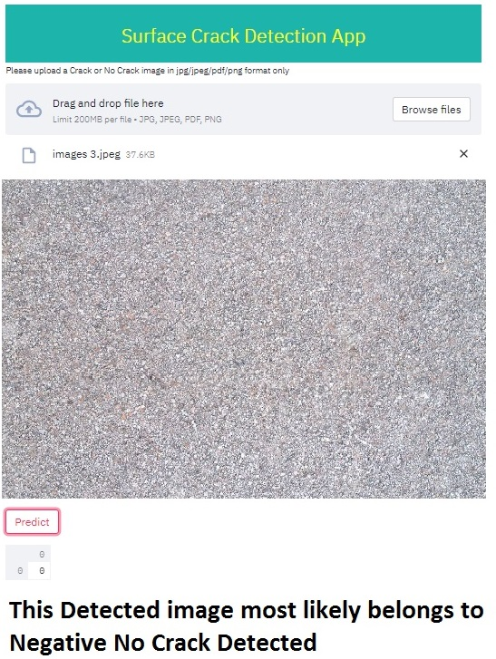
LAUNCH APP

Slide 15
Credits
Dataset
Courtesy : Mendley Data (http://dx.doi.org/10.17632/5y9wdsg2zt.2)
Tensorﬂow
Keras, Image Preprocessing
OS Module
Path - Directories
Kaggle Notebook
IDE
Python

Slide 16
THANK
YOU

